Slide 1
Exercises 1 – Running your 1st experiments Tutorial @ IE2025
Dr.-Ing. Christian Beyer | 24.06.2025
christian.beyer@ovgu.de
Notes:
Multi-Task Learning → partly true, →do not share structure unless ensemble → different training data but same task
Recommenders rely user-user or item-item similarities. -> ignored
Recommenders often aggregate data across entities. ->not yet.
Recommenders seek cross-entity generalization (e.g., new users/items).
Entity-centric learning focuses on intra-entity generalization, avoiding global patterns.

Slide 2
Exercises 1
1) Use mixed_5k_shift dataset and compare the performance of the RandomScorer vs. the AEDScorer using all available AFA strategies (k-best, k-global-best, k-max-mean) → Which combinations use the most/least budget? → Which combination performs best (and why)?

Slide 3
Exercises 1
2) Take the best combination from exercise one and try different levels of missing data (0.1, 0.25, 0.75, 0.9)? → What are the effects on performance and budget use?

Slide 4
Exercises 1
3) Try different feature cost settings (‚increasing‘, ‚decreasing‘, ‚equal‘) → What happens to the performance and budget use?

Slide 5
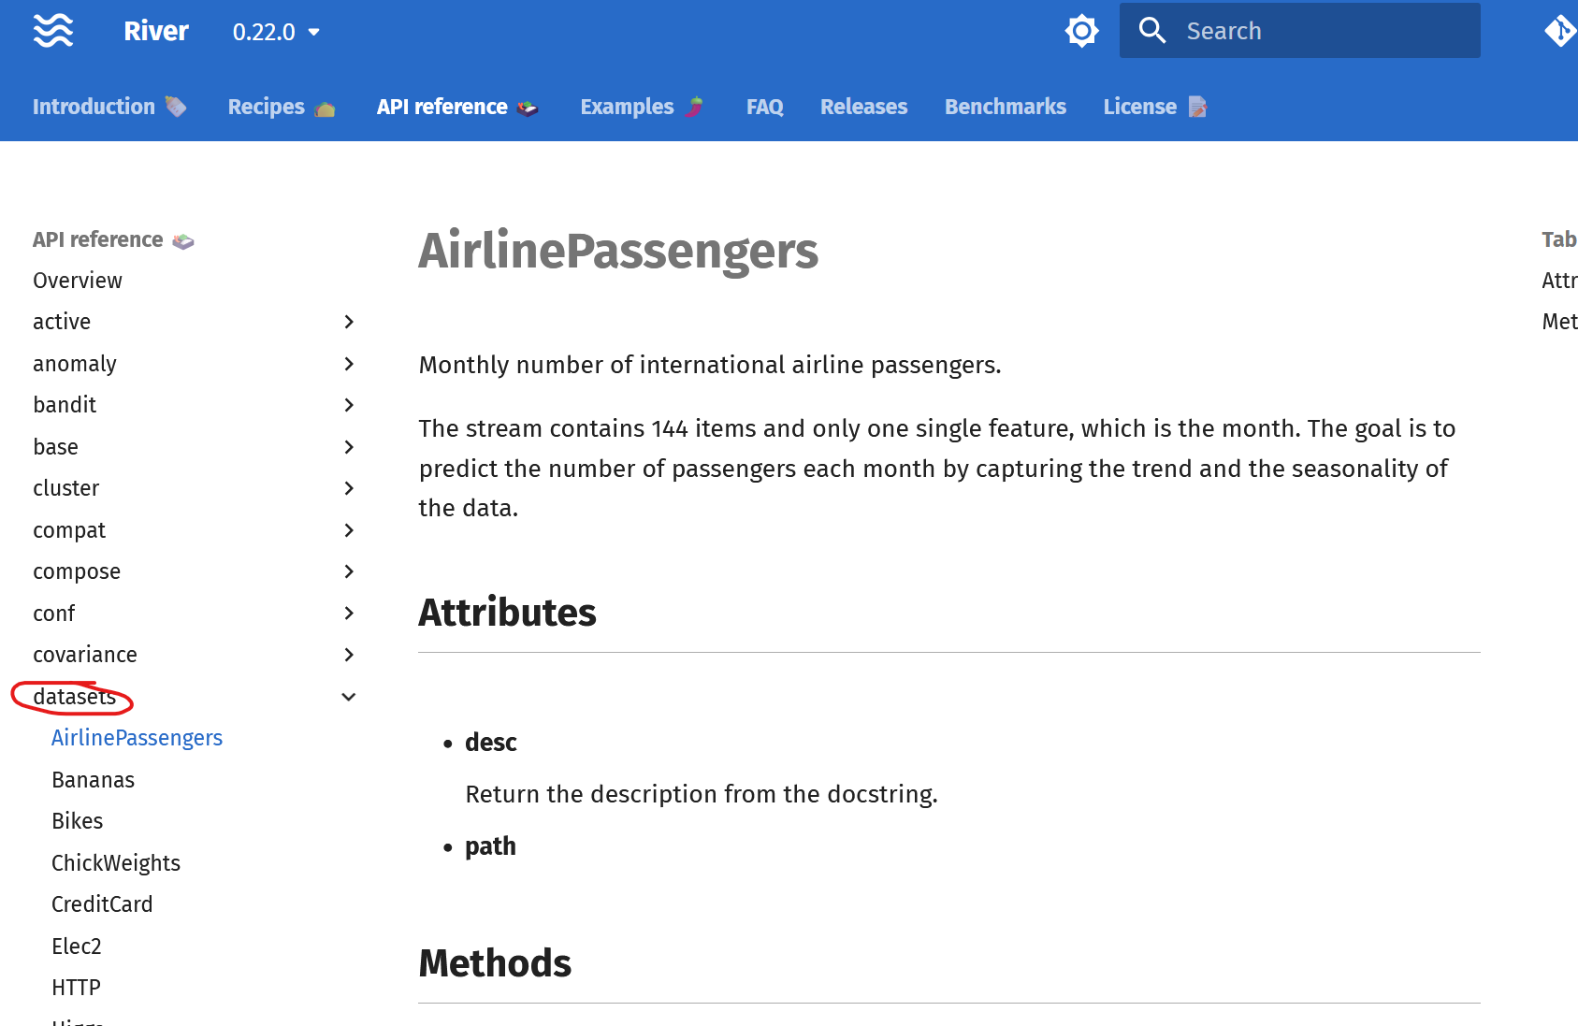
Exercises 1
4) Try different datasets (easiest is to use river datasets) and classifiers (some only work on purely numerical data e.g. random forest)
→ What differences in performance to you observe when using different classifiers? → Which features have the highest merit on your dataset?

